Slide 1

Electrical and Computer Engineering Senior Design (EE491W)
Risk Management and Prototyping Plan
Team 9 - HANDS-EMG
Hand Activity Neural Detection using sEMG
Notes:
Blake

Slide 2
System Description
Our ECE team is developing a battery-powered surface electromyography (sEMG) sensor system designed to classify hand movements based on the wearer’s muscle activity. The device utilizes four channels of wet electrodes placed on the user’s forearm to capture sEMG signals. These signals are processed through our procured analog front-end module operating at a minimum of 2000 samples per second. The digitized signals are transmitted to our microcontroller via SPI, where a machine learning algorithm classifies the hand movements based on a pre-trained model. Our responsibilities include configuring the analog front-end module, programming a low-power microcontroller, integrating the system on a custom PCB, and training the machine learning model for accurate classification. The system will output the movement classifications via USB, which can be visualized on a PC simulator. Designed for efficiency, the device operates at a voltage of 3.7V provided by a rechargeable lithium polymer battery for portability.
Notes:
Noah

Slide 3
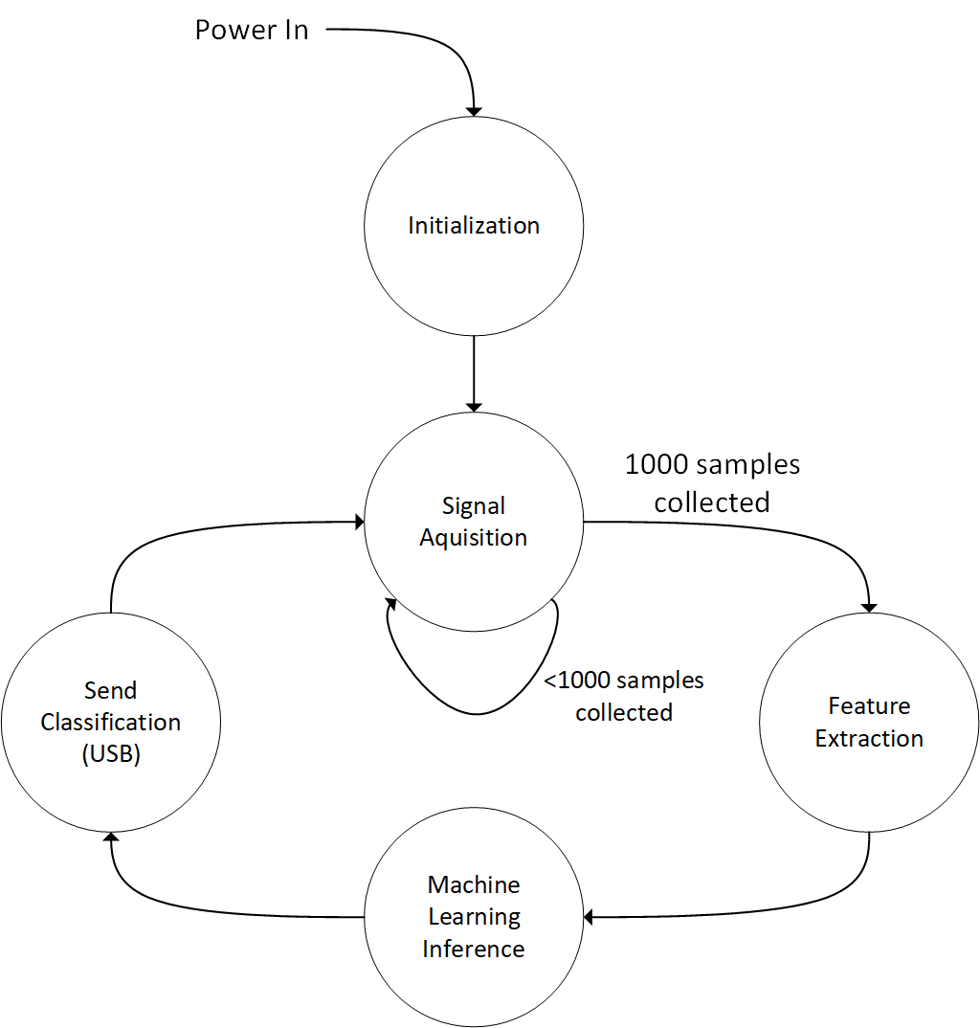
Finite State Diagram
The finite state diagram figure shows the main processes that our device performs when powered on.
Notes:
Blake

Slide 4
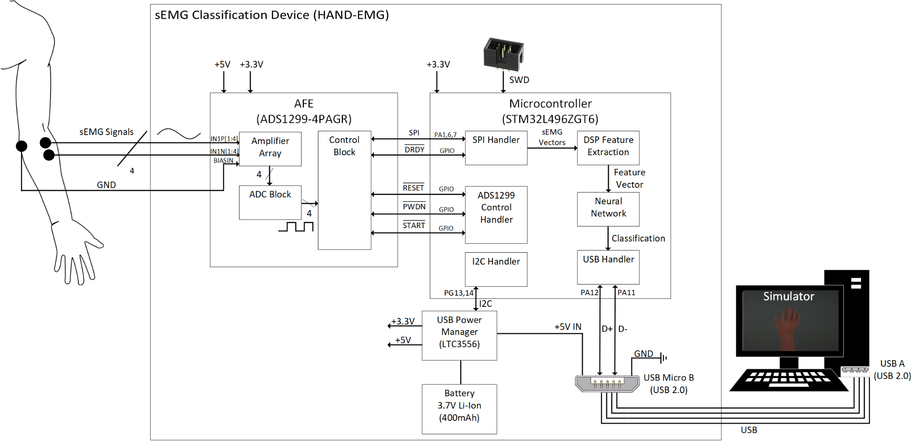
Block Diagram
Figure 2
Notes:
Blake

Slide 5
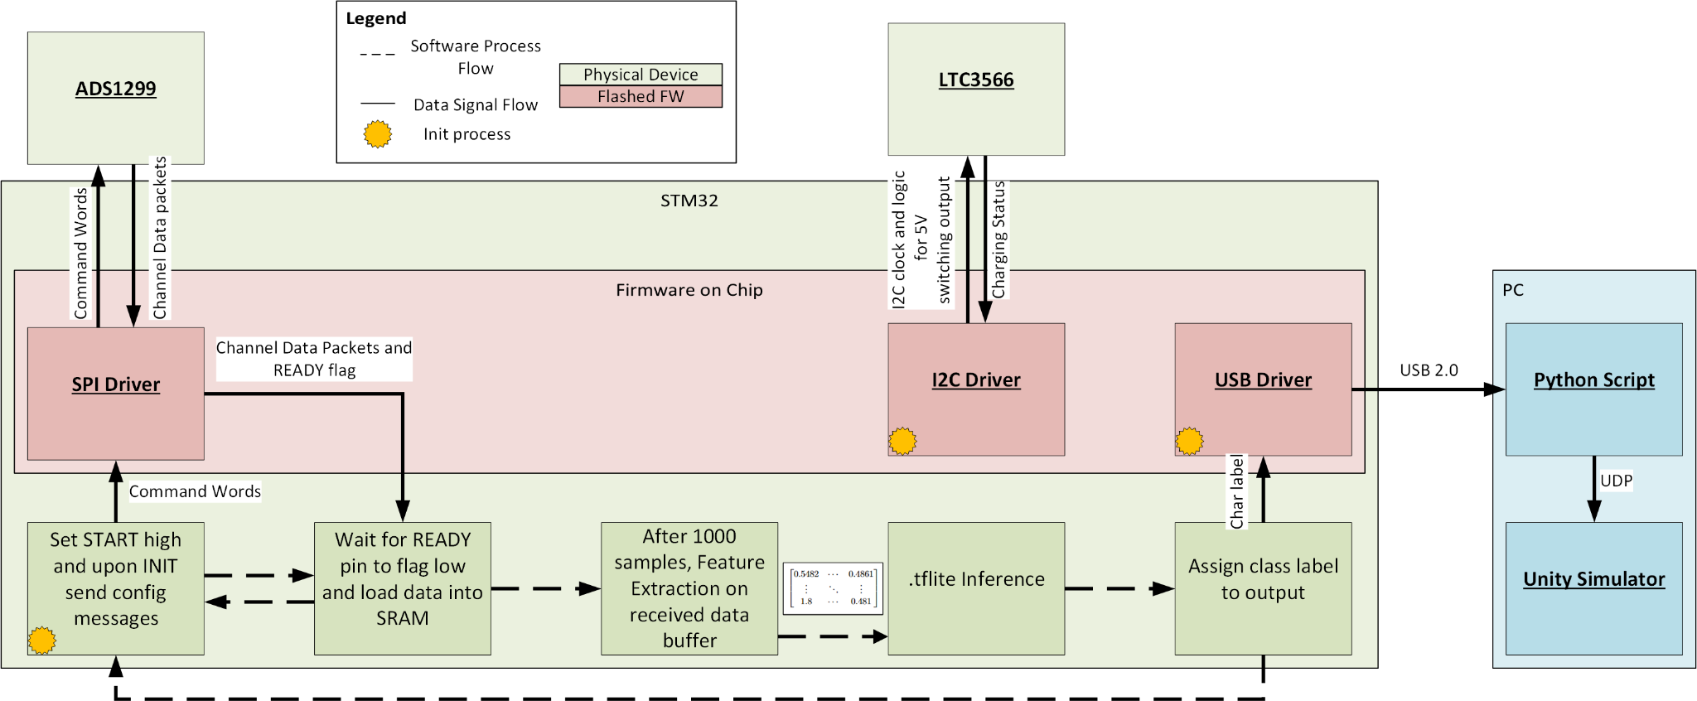
Software Layout
Figure 3
Notes:
Noah

Slide 6
Project Risks

Slide 7
Risks that affected project definition
 | Risk | Description | Project Change
1 | Use of dry electrodes | Dry electrodes presented impractical complexity due to the added impedance and noise. In our analysis there was also a lack of data for dry electrode based classification. | Project was changed to use wet electrodes. These remove the complexity faced with dry electrodes and have a ubiquitous amount of public datasets for classification models.
2 | Time to design custom power management system | Designing a custom battery charger and regulation circuit was impractical due to the extensive time required. | Project was changed to procure a USB power management IC.
3 | Research and design for a custom analog front-end module | Designing an analog front-end that would amplify, filter, and sample our emg signals was impractical due to the engineering complexity. | Project was changed to procure an analog front-end module designed for biomedical purposes that handle the listed activities.
Notes:
KELLY

Slide 8
Summary of low/non-risk items
 | Risk | Reason
1 | Power Management | Providing power to our ICs via a 3.7V rechargeable li-ion battery is well documented for both the STM32 and ADS1299 including implementation examples in their respective datasheets. USB power manager (LTC3556) has been selected as our solution.
2 | Communication Protocols | The SPI, I2C, and USB communication protocols are well defined and documented. Communication is handled by the STM32’s hardware modules for simplicity. Team member has experience with SPI and I2C.
3 | Enclosure | A plastic enclosure will be procured from DigiKey and holes will be drilled for external interfaces.
4 | Public Data Availability | Team has identified public database “Ninapro” with 10 datasets including over 180 data acquisitions. Team has identified other public datasets as backup.
5 | Deploying Machine Learning on STM32 | Deploying a TFLite Micro model to STM32 is well documented with open source projects and internal STMicroelectronic documentation available. The documentation includes over 5 examples, a walkthrough, and troubleshooting information.
Notes:
Jayden 3 minutes
(try not to read off completely, it’ll take too long summarize it as much as possible)

Slide 9
Risk Cube
 | Risk | Probability | Impact | Mitigation
1 | ML Classification Accuracy | 3 | 5 | Testing will take place with public data and AFE acquired data.
2 | ML Model Size | 2 | 3 | ML model will be adjusted incrementally beginning in phase 1.
3 | DSP Algorithms | 2 | 4 | Close communication with project mentor. Algorithms are already being prototyped in C.
4 | AFE Configuration | 2 | 5 | Signal acquisition testing begins early in phase 1 with all materials ordered. Allowing team 4 weeks of prototyping.
5 | PCB Design Complexity | 3 | 4 | Three separate PCBs will be designed for each module. Then integrated into a single board after debugging.
6 | System Integration | 3 | 5 | Modules will be tested individually with debugging tools to ensure proper technical characteristics before integration.
5
4
3 |  |  |  | 5 | 1,6
2 |  |  | 2 | 3 | 4
1
 | 1 | 2 | 3 | 4 | 5
Probability
Impact
Figure 4
Notes:
KIRK

Slide 10
Risk Table
 | Risk | Description | Probability | Impact
1 | ML Classification Accuracy | An accurate machine learning model is necessary to make consistent classifications of movements. Standard accuracy of between 70% and 90% is necessary. | Datasets with over 180 acquisitions specifically for this application were identified. Analysis of similar models coupled with a considerable amount of data show this accuracy is possible. The probability is estimated as 3. | A system with a low accuracy model will often provide incorrect classifications. A completely inaccurate model will not provide any classifications. The impact is estimated to be a 5.
Notes:
Blake

Slide 11
Risk Table
 | Risk | Description | Probability | Impact
2 | ML Model Size | Machine learning models can be computationally expensive and large in size. Deploying this on a microcontroller with limited memory is a risk factor. | The STM32L4 we selected has 1MB of flash. Analysis of literature and existing projects show EMG classification modules operating on 1MB devices. The STM32U5 with 4MB has been identified as an alternate option with the same pinout. The probability is a 2. | Model complexity is an important factor to its size. If model size presents itself to be an issue, then a new model will be trained with less gestures to classify. The impact is a 3.
Notes:
BLAKE

Slide 12
Risk Table
 | Risk | Description | Probability | Impact
3 | DSP Algorithms | The digital output of the ADS1299 needs to be processed prior to feature extraction to ensure that captured data matches training data, if the features extracted are not within an acceptable range, the inferences will be inaccurate | The features being used are non-intensive, and upon analysis, the datasets being used are in an easy to modify format. STM also runs subroutines to dedicate majority processing power to feature extraction. Additionally, the literature backs up our specified features as an industry standard. Probability is a 2. | If the signals are not properly conditioned, or the MCU is unable to perform feature extraction as on our PC, the machine learning model performance will suffer, thus the impact is a 4.
Notes:
Noah

Slide 13
Risk Table
 | Risk | Description | Probability | Impact
4 | AFE Configuration | The ADS1299 module has many configuration options including amplifier gain and sampling frequency. The proper combination of these options is necessary to receive a clean sEMG signal for classification. | Existing research for the use of the ADS1299 for EMG has been identified. The ADS1299 was selected at the advice of our project advisor who has used it previously for similar applications. For this reason the probability is a 2. | Our project relies heavily on proper signal acquisition. Without proper signals, the microcontroller will fail to classify the movement. The impact is a 5.
Notes:
Kelly
Add for AFE has data sheet examples as well

Slide 14
Risk Table
 | Risk | Description | Probability | Impact
5 | PCB Design Complexity | Currently, the proposed system utilizes three ICs with a combined chip area of 564mm², and a total number of 236 pins. This increases the complexity needed for the PCB layout substantially | Each devices data sheets provide examples of schematic setups for implementing on a custom PCB. Breaking up the PCB design by component, we can more easily finalize. Our eval boards will give us hands on knowledge of the boards and necessary pinouts. Probability is 3 | If design of PCBs is not done properly, there could be problems with noise or signal degradation, which would affect the data received/outputted giving inaccurate results. Impact is 4.
Notes:
Jayden

Slide 15
Risk Table
 | Risk | Description | Probability | Impact
6 | System Integration | Our proposed system has 3 major components. Power management, analog front-end, and the microcontroller which all have different control and communication protocols. | While creating each PCB, there will be thorough testing and debugging for each system to ensure they work individually before full integration. Also, the communication modules will have a working prototype Probability is 3 | Since we are on putting all three systems on one PCB, if the subsystems are unable to communicate properly, or the physical layout was done incorrectly, then the total system would fail. Impact is 5
Notes:
Kirk

Slide 16
Prototyping Plan

Slide 17
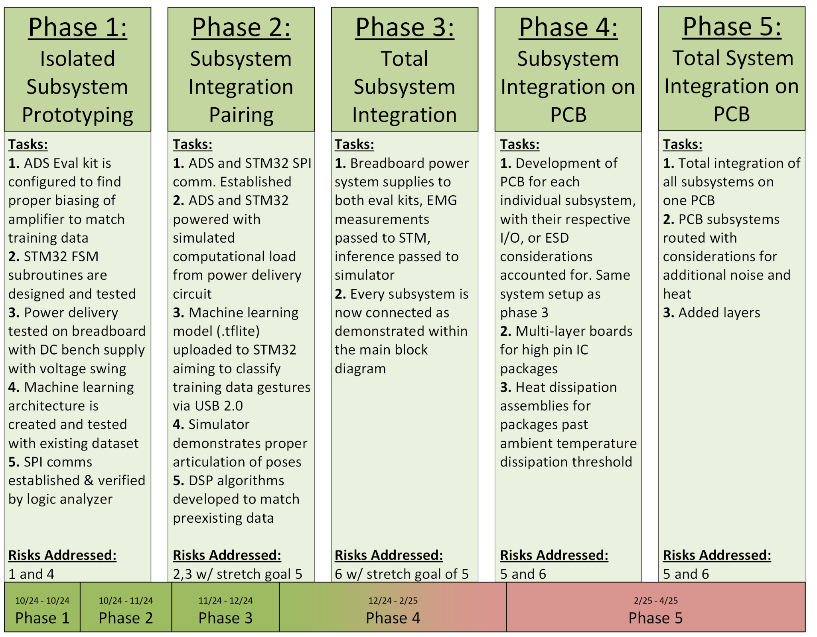
Prototyping Roadmap
Note the bulk of prototyping activities are present in phase 1 & 2, as most tasks from phase 3 onward involve considerable debug effort
Figure 5
Notes:
Jayden

Slide 18
Phase 1 Description
Our prototype activities in phase 1 will target Risk #1 (ML Classification Accuracy) as well as Risk #4 (AFE Configuration). These risks were targets for initial prototyping in phase 1 because of their high impact on the project. The prototyping activity will consist of coding our subroutines on the STM to ensure proper functioning, building and training our ML model to ensure viable accuracy, finding the correct biasing of the PGA, configuring our PMIC to properly output the desired voltages, and verifying the SPI communication follows standard protocols. The devices and tools needed to complete this phase have already been procured. The activity will involve programming the MCU and the ADS using their prebuilt GUI, identifying proper protocols in both sets of SPI interfaces, and finally measuring test points along the QFN-28 to DIP-28 connector.

Slide 19
Phase 1 Activity Steps
ADS Configuration
Place electrodes on arm as described in “Electrode Placement Protocol” and connect them to the eval board
Connect the eval kit to the PC, and open the TI ADS1299EEGFE Software
Adjust the gain of the channel preamplifiers to match the frequency content and amplitude of the acquired signals to that of the training data
STM32 Subroutine
Connect the STM32 board to the PC
Open the CubeIDE software to program the STM32
Design and debug subroutines to follow the functionality of our block diagram
LTC3556 Verification
Solder the QFN-28 LTC3556 onto the DIP-28 converter (designed item) with header pins
Plug into breadboard
Locate the pin labels on the converter, and align them to match the input voltage
Machine Learning Model Construction
Use preexisting TensorFlow Lite libraries to construct a ML model that the STM is capable of utilizing
In Matlab, format the data as it will be done on the MCU, including the windowing size, method, and actual features extracted from each window
Separate data into a 70/20/10 split for training, validation, and testing data
Train the model, adjusting hyperparameters as needed
SPI Communication Establishment
Utilizing the firmware packages on the STM32, send some example messages via SPI to a logic analyzer
Tune the device if unexpected messages are occurring (likely timing errors within the code)
While capturing data, pulse the START pin high and visualize the output of the SPI lines along the logic analyzer

Slide 20
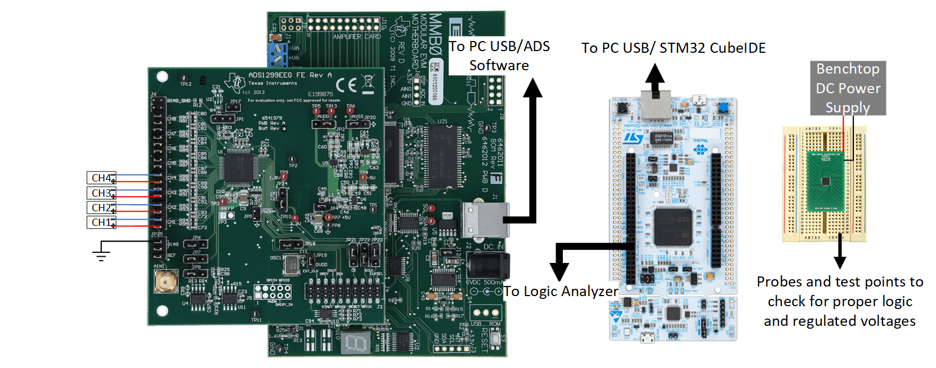
Figure 5 shows our isolated subsystem prototyping. Connections are simplified for readability
Figure 6
Notes:
NOAH

Slide 21
Phase 2 Description
Our prototype activity in phase 2 will target Risk #2 (ML Model Size), and Risk #3 (DSP Algorithms) with a stretch goal of Risk #5 (PCB Design Complexity). These risks were targets for early prototyping in phase 2 because of their high impact on the project. The prototyping activity will consist of writing the necessary code to establish communication between the ADS and STM32, powering both devices with our power delivery circuit with a simulated computational load, uploading the trained machine learning model to the STM32, and developing the necessary DSP algorithms to produce features. The devices necessary to conduct this prototyping phase have already been procured. The activity itself will involve capturing the communication between the STM32 and ADS using the logic analyzer to visualize the waveforms on matlab, and feeding the training data to the uC via USB and viewing the classification that is outputted.

Slide 22
Phase 2 Activity Steps
Power Management Verification
Connect power management circuit to USB Micro B power delivery.
Connect +3.3V output to STM32 Vin.
Connect +5V output to ADS1299 Vin.
Verify both boards constant power and are able to connect to PC for programming.
ADS1299 and STM32 Communication
Write SPI communication code for STM32
Connect ADS1299 SPI lines to STM32 SPI lines.
Use ADALM2000/AD3 to verify SPI communication occurring.
Use ADALM2000/AD3 script to capture SPI packets and visualize sEMG signal sent.
PC Simulator Verification
Open the open source Unity simulator on PC.
Create python script that will send fixed test poses to simulator via UDP socket.
Verify simulator displays the poses in the sent test sequence.

Slide 23
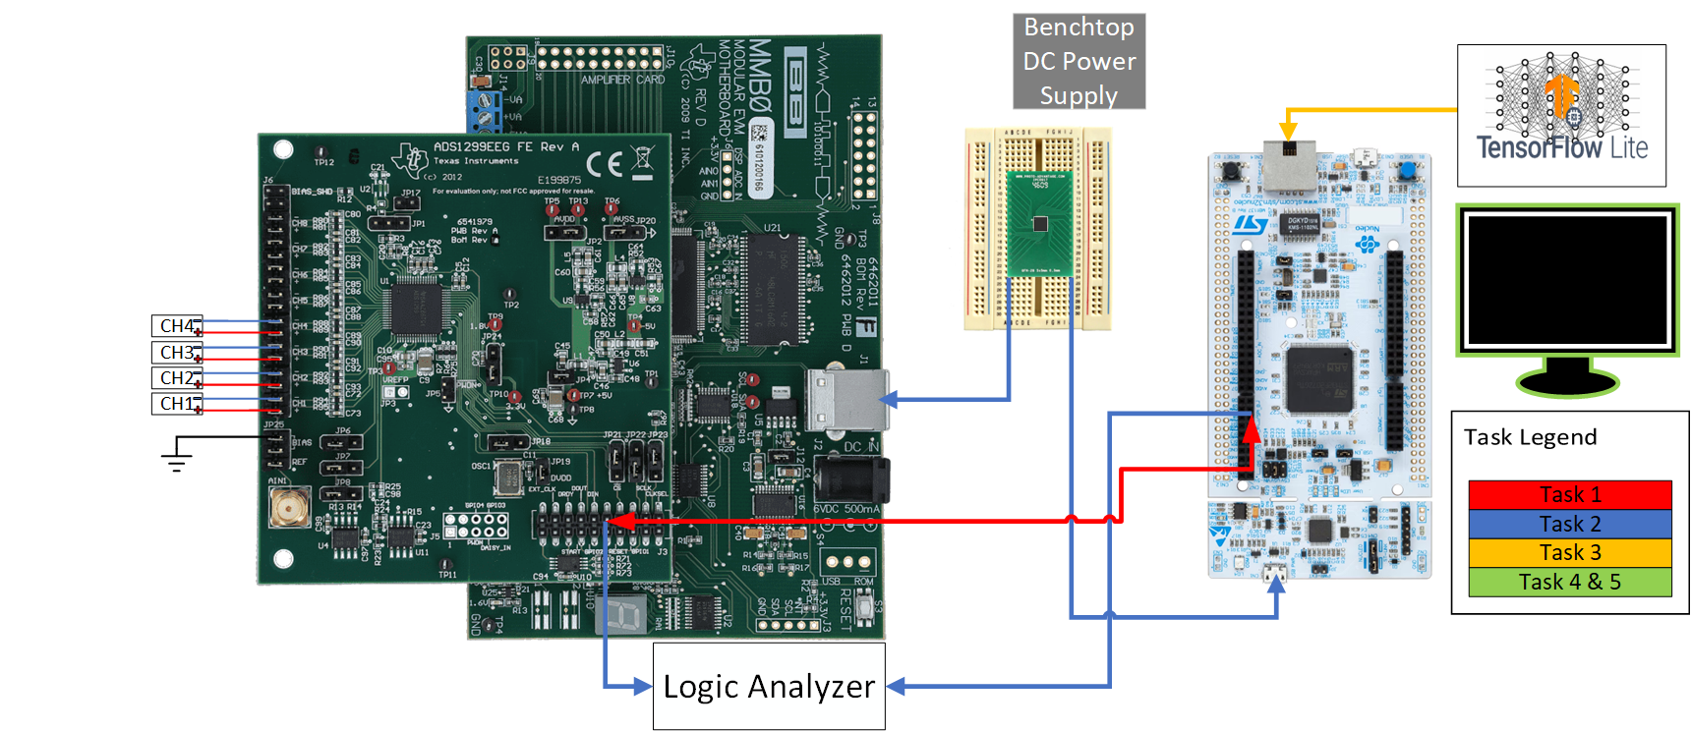
Note: The task legend in figure 5 refers to all tasks listed in phase 3 within figure 4 (Prototyping Roadmap). Every task that is a different color are tasks that occur independently, with the exception of task 4&5, which share the same color, but are also independently performed
Figure 7
Notes:
BLAKE

Slide 24
Phase 3 Description
Phase 3 addresses Risk #6 (System Integration) with a stretch goal of Risk #5 (PCB Design Complexity). This phase showcases the integration of an EMG measurement subsystem using evaluations kits, highlighting the capture and transmission of muscle signals for analysis. The setup with an EMG sensor attached to the target muscle, measuring electrical signals generated by contractions and sending them to the (AFE), which amplifies and filters the signals.
The ADS1299 ADC then converts these amplified signals into digital data. This data is processed by the STM32L496ZG6ZGT6 microcontroller, programmed to initialize the ADC and set a sampling rate of 2000 samples per second (SPS). The microcontroller continuously reads the data and transmits it via I2C or SPI to a computer running simulation software.
The simulation software visualizes real time EMG waveforms, offering immediate feedback on muscle activity and analytical tools for filtering and peak directions.

Slide 25
Phase 3 Activity Steps
Total Subsystem Integration
Place all subsystems and eval kits on the same ESD safe workspace
Connect and remove necessary jumpers on the ADS1299EEGFE as per the documentation instructions
Wire the SPI Lines according to the pinout specified in the block diagram (figure 2)
Plug the micro USB into the USR_DTA port of the STM32 eval kit
Wire the I2C from the LTC3556 to the STM32 according to the pinout specified in the block diagram (figure 2)
Locate the AVdd pin on the ADS eval board, and connect the 5V output of the PMIC to that pin
Locate the DVdd pin on the ADS eval board, and the PWR_IN pin on the STM32 eval kit, and connect that to the “Always on” 3.3V line of the PMIC
Finally connect the battery, and wait for the system to initialize
After init period, the data should be displaying on a PuTTy window, which verifies functionality of the device

Slide 26
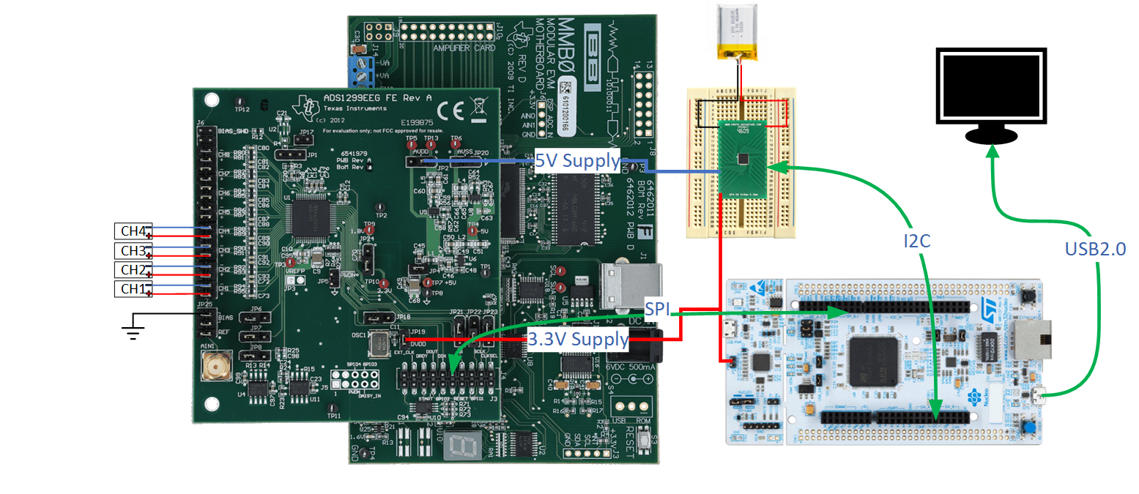
All devices now show a physical connection. This phase addresses the integration issue, by ensuring connectivity between devices before being placed on a PCB (which will begin its preliminary design process during this phase).
Figure 8
Notes:
KIRK

Slide 27
Phase 4 Description
Our Prototype activity in phase 4 is targeting Risk #5 (PCB Design and complexity) as well as Risk #6 (System Integration). These had posed a significant impact on the project so addressing them was made to be an important part of the prototyping process. This prototyping process will be the application of the eval testing into KiCad with the necessary pinouts found in phase 3 onto individual PCBs for each subsystem. The power delivery circuit will power both the ADS and the STM32, input signals will be processed and sent to the microcontroller, and the microcontroller will be able to receive those ADS signals to process and classify as movements for the simulator, as well as monitor the charging circuit for the power circuit. ESD considerations also accounted for (via Decoupling coupling and proper ground planes), as well as heat dissipation methods where necessary (via capacitors near power pins and trace designs that can handle higher currents AKA wider traces where needed).

Slide 28
Phase 4 Activity Steps
Modeling PCBs
Based on phase 3 testing, use KiCad to create each PCB subsystem with the correct pinouts
Test each circuit in the PCB simulation and verify all pinouts are correct and can communicate with the other subsystems where necessary before printing
Power Management Circuit
Connect battery to USB Micro B
Connect +5V output to ADS1299 Vin
Connect +3.3V output to ADS1299 Vin and STM32 Vin
ADS1299
Verify connecting points of electrodes and ensure the board has proper grounding for the analog and digital inputs voltage inputs
Connect via SPI to the STM32
STM32
Ensure connection from ADS, power circuit, and connect Via USB micro to simulator
Run through commands to receive signals from ADS and process them with correct classification onto the simulator

Slide 29
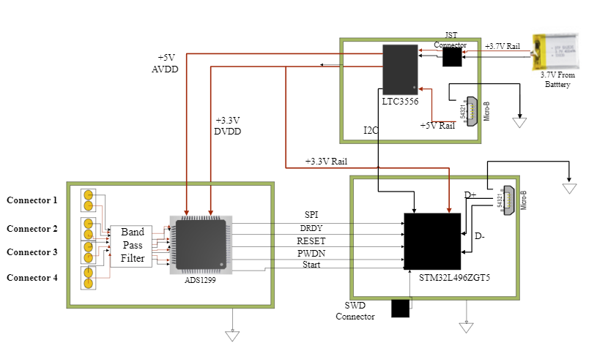
Each PCB design incorporates the I/O connections and ESD protection now, as well as necessary heat sinks and grounding planes for each one. This phase is ensuring each PCB functions and communicates properly with each other before full integration.
Figure 9
Notes:
KELLY

Slide 30
Phase 5 Description
Our prototype activity in phase 5 will target Risk #5 (PCB Design Complexity), and Risk #6 (System Integration). The phase 5 activity involves taking the three separate subsystems and integrating them into a single PCB. As previously mentioned in phase 4, the subsystems consist of power management, ADC, and the microcontroller. Each subsystem must be precisely routed in order to minimize the amount of noise interference and heat dissipation. Throughout the design and layout process we must ensure that the analog and digital components stay separate, use short signal paths, and opt for a multilayer PCB to isolate power and signal planes. This activity is crucial in order to preserve the signal integrity of our analog inputs.

Slide 31
Phase 5 Activity Steps
Integrate power management, ADC, and microcontroller subsystems into a single PCB
Route signal paths as short as possible to minimize noise interference
Place decoupling capacitors near each subsystem’s power pins to filter noise
Implement thermal management by placing heat sinks near heat-sensitive components
Use a multilayer PCB to isolate power, ground, and signal planes to reduce cross-talk

Slide 32
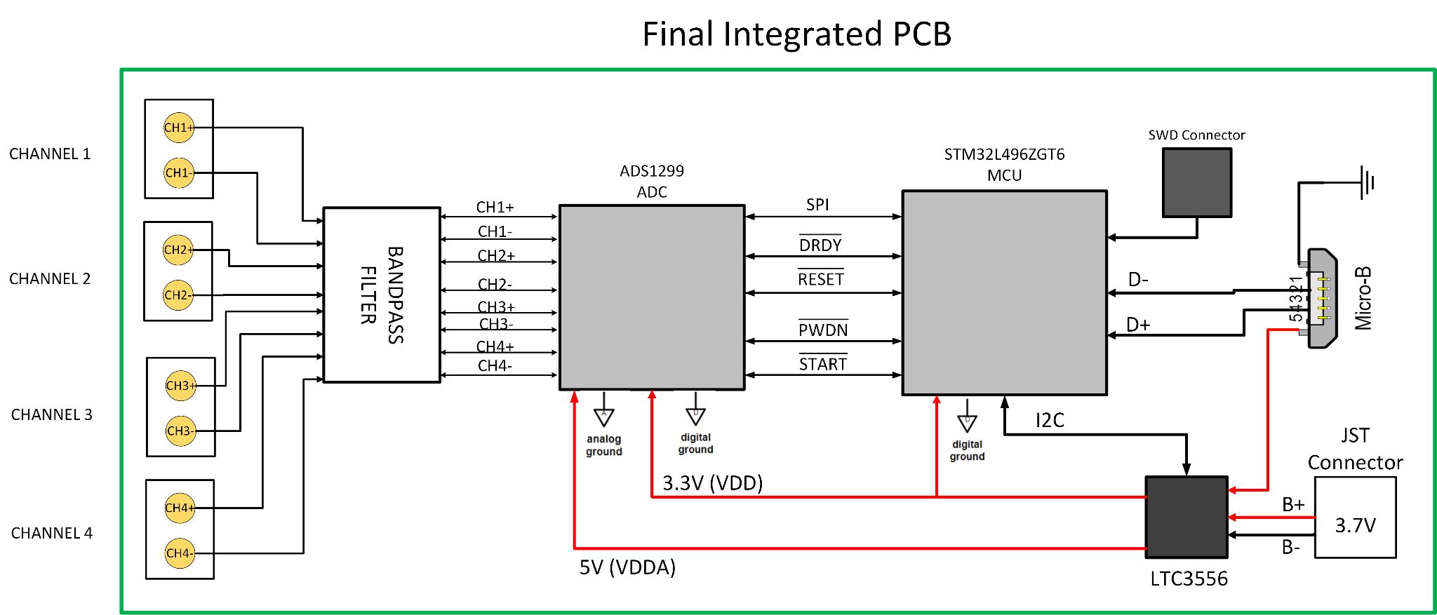

Figure 10:
The three separate subsystems are integrated onto a single custom PCB. Each subsystem are precisely routed with consideration for noise and heat. Layers are added to PCB in order to support complex routing and efficient power distribution.
Notes:
JAYDEN

